Slide 1
BIOE 498 / BIOE 599: Computational Systems Biology for Medical Applications CSE 599V: Advancing Biomedical Models Lecture 14: Data Management for BioMedical Models
Joseph L. Hellerstein*
Herbert Sauro**
*eScience Institute, Computer Science & Engineering
**BioEngineering

Slide 2

Biological Data

Slide 3
Requirements & Solutions
Requirement
Solution
Can find the data
Provenance
Know data semantics
Ease of update
Ease of query
Ease of storage
Can validate
Version control
Version control
Documentation
Data management
Data management
Data management
Data tests

Slide 4
Agenda
Case study – Co-evolution of 2 microbes
Data modeling primer and application to case study
SQL with demo
Building SQL repositories in python
In-class exercise

Slide 5
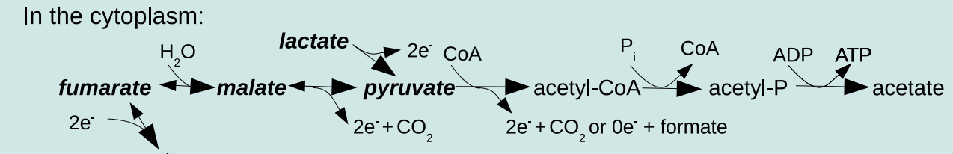
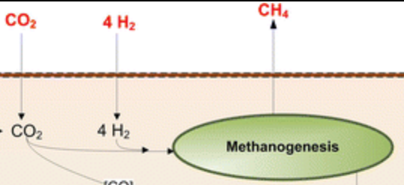
Case Study – Co-evolution of Desulfovibrio vulgaris Hildenborough (DVH) & Methanococcus maripaludis (MMP)
DVH
﻿å
MMP
Together, DVH + MMP complete

Slide 6
Experiments & Data Collected
Resistance = {R,E,S,A}
DVH
MMP
Line = {H,U} X {R,E,S,A}
not resistant
resistant
not resistant
H
U
H
U
H
U
H
U
Line Replicas
End Point Dilutions
1,000 generations
DVH
Isolate
MMP
Isolate
Mutation Data
Mutation Data
Culture
Growth
Data

Slide 7
Growth Rate and Yield
Analysis to determine growth rates and yields

Slide 8
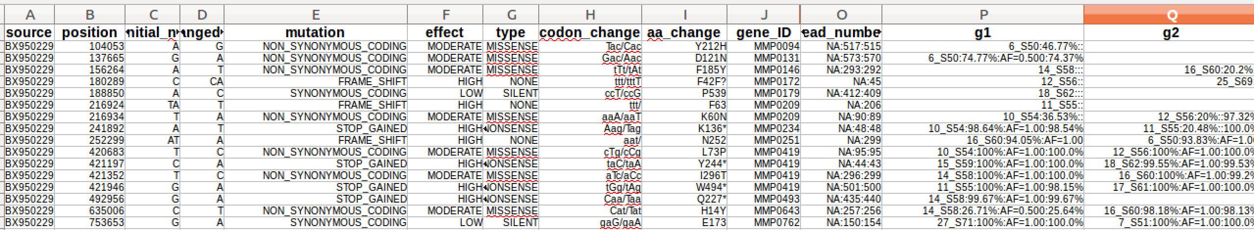
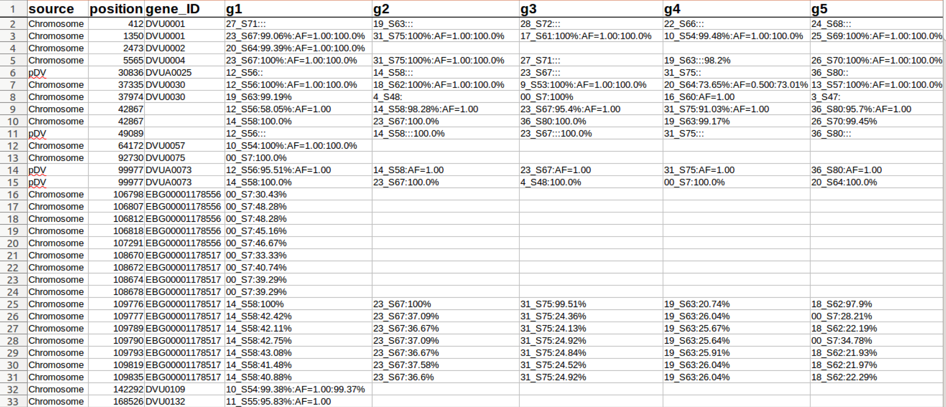
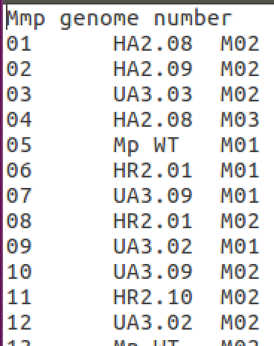
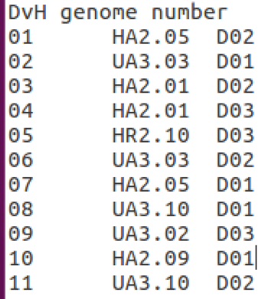
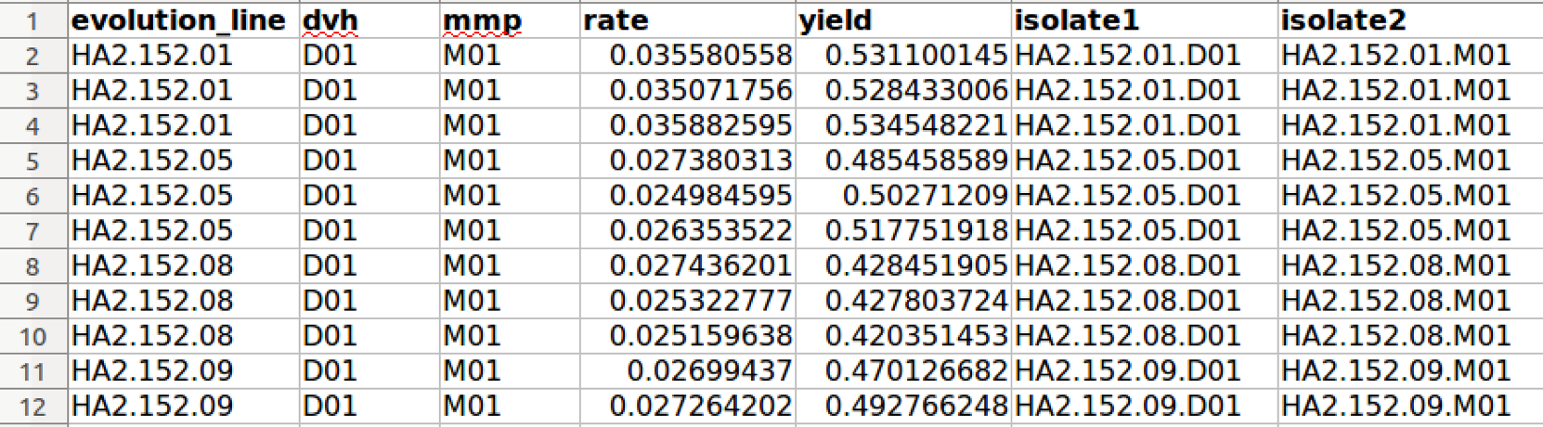
Raw Data
mmp_mutations.xlsx
dvh_mutations.xlsx
names_colonal_isolates_dvh.txt
names_colonal_isolates_mmp.txt
Complex
Error prone
Inflexible
growth_data.xlsx
Notes:
Introduce mutations and cultures.
Establish goal of finding mutations for cultures as is done in the PhenotypeExplorer
Show intermediate fine and navigation
Analysis programs must: do linkage, parse, create a navigation plan for novel combinations

Slide 9
Problems With This Approach
Difficult to navigate
Difficult to validate
Inconsistent names

Slide 10
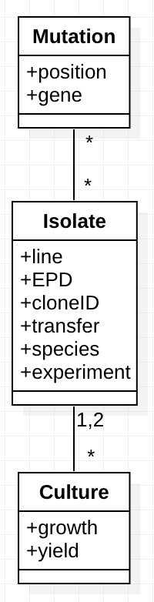
Need to Structure Data To Answer Questions
H
U
H
U
H
U
H
U
Line = {H, U} X {R, E, S, A}
DVH
Isolate
MMP
Isolate
Mutation
Mutation
Culture
What combinations of mutations in Dvh, Mmp result in larger growth rates and/or yields?
Culture has growth_rate, yield
Mutation has position, gene (if any)
Linking Culture with Mutation requires doing “joins” with Isolate

Slide 11
What is an Isolate?

Slide 12
Space vs. Query Simplicity

Slide 13
Use of SQL DB

Slide 14
SQL and Python
Pandas dataframes
Creating a SQL DB
Sqllite3 command line and queries

Slide 15
In Class Exercise

Slide 16
BACKUP

Slide 17
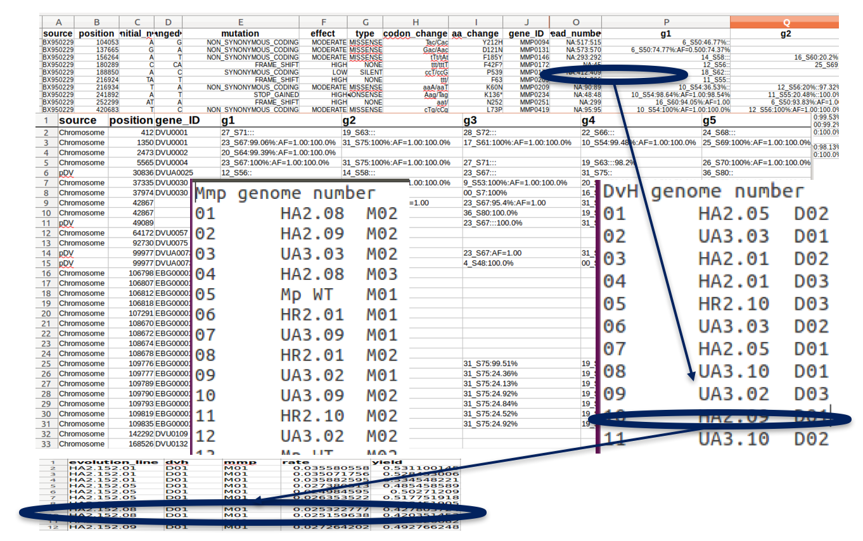
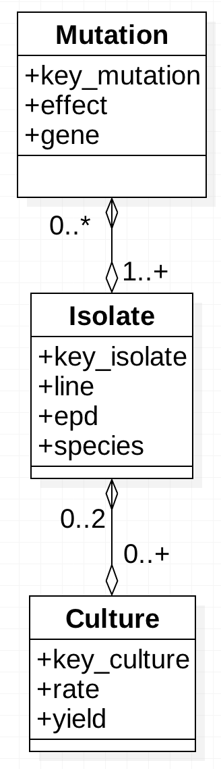
Engineering Data Navigations
“View” computes a single table that integrates the data.
+ changed_nt
Mutation
Isolate
Culture
Challenges
Low coverage isolates -> no mutations
Hold-out isolates -> no cultures
Not lose mutations, isolates, cultures
Not create phantom mutations, isolates, cultures
Notes:
Principles
Mutation – separate collection of data; no gene because can be computed from the key.
Show mutation and its attributes
Show connections with isolates and interrelationships
Show culture
Show database principles
Show resulting view
Line, epd, species can be computed

